Slide 1
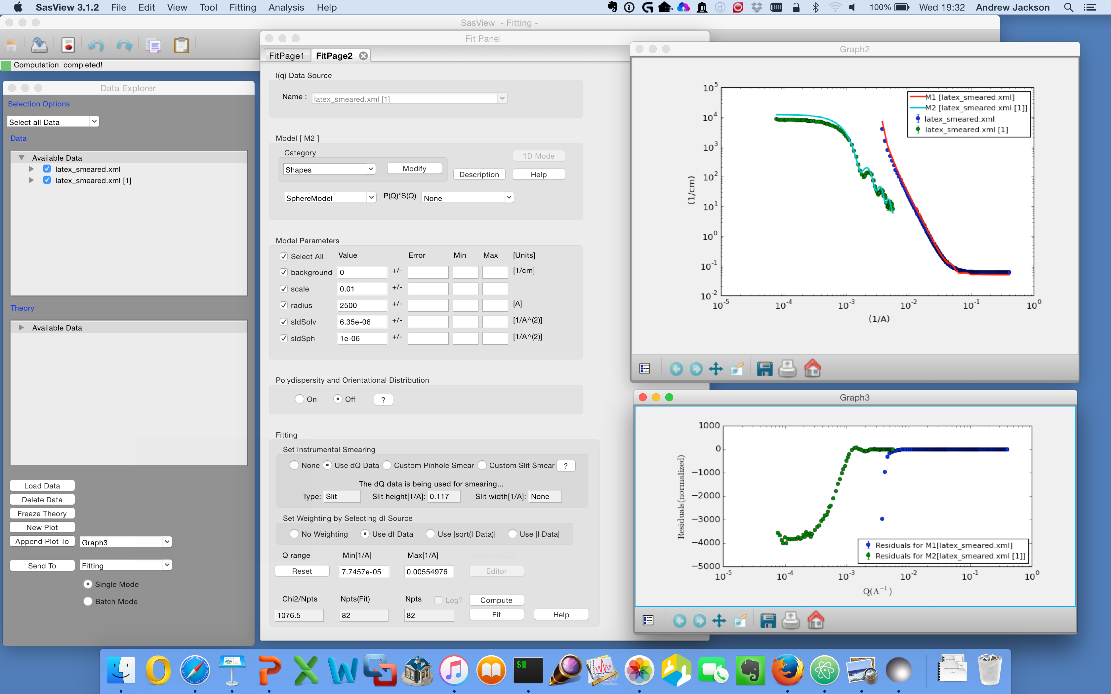
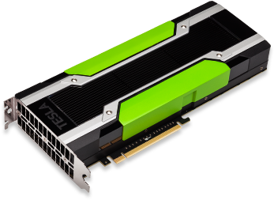
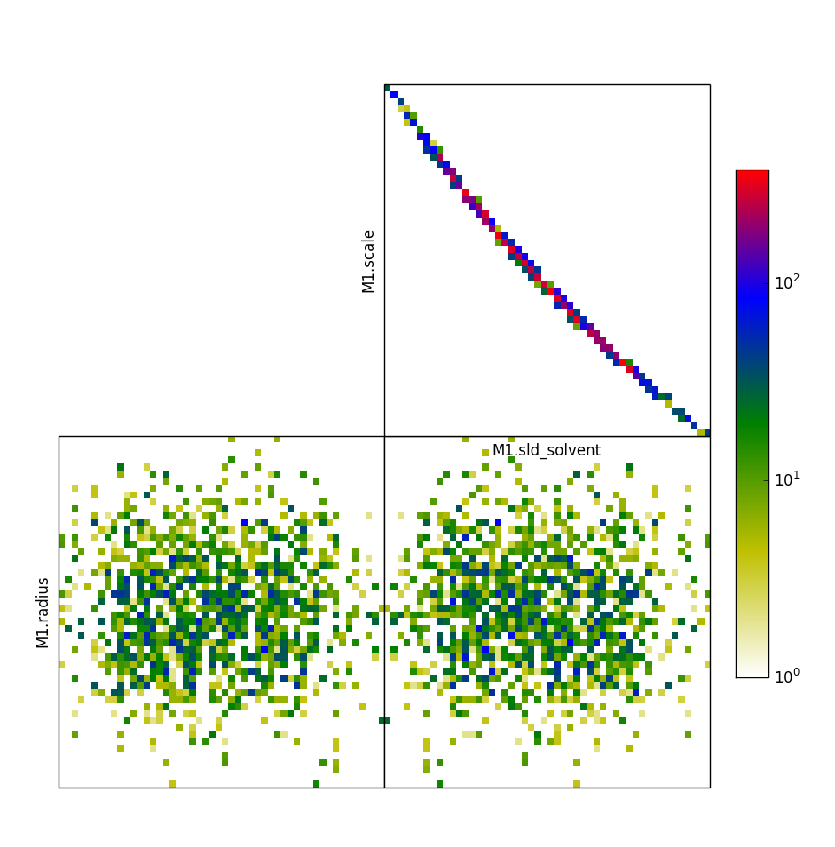
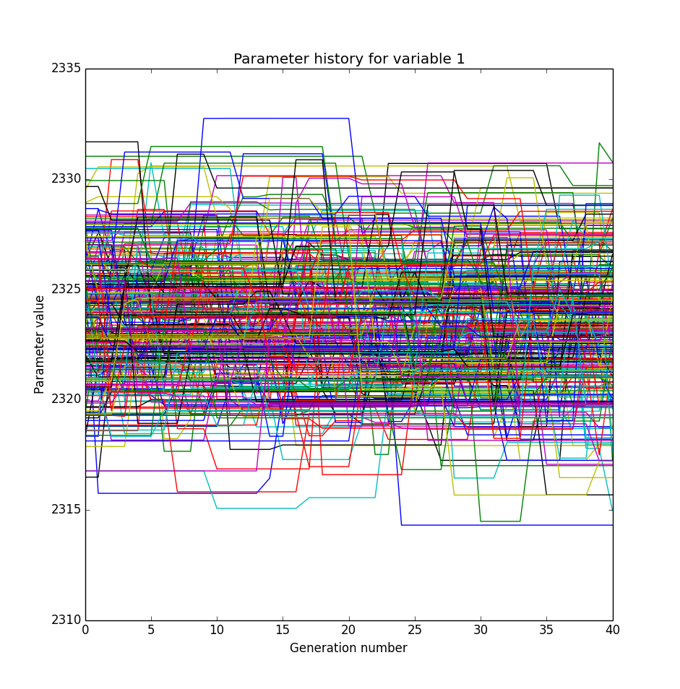
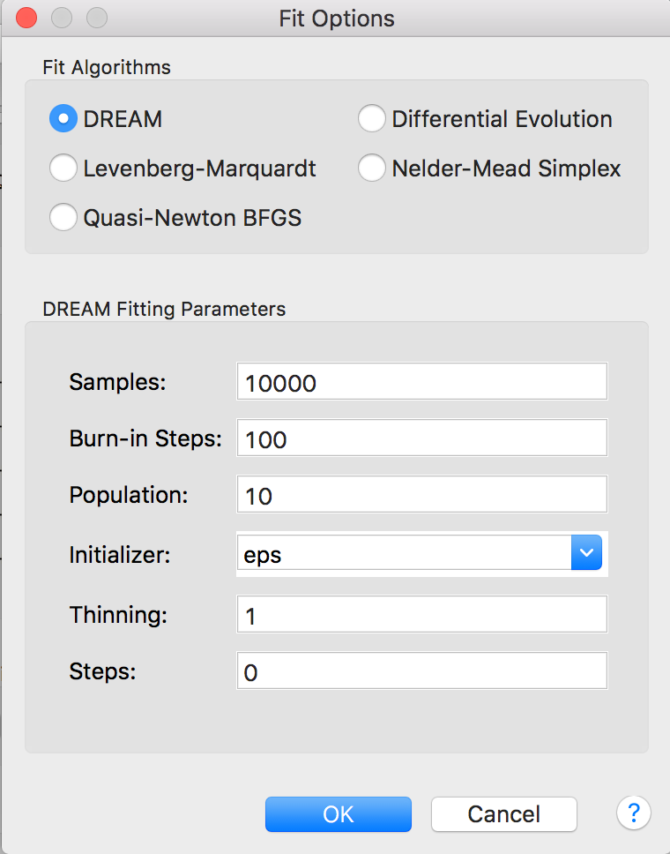
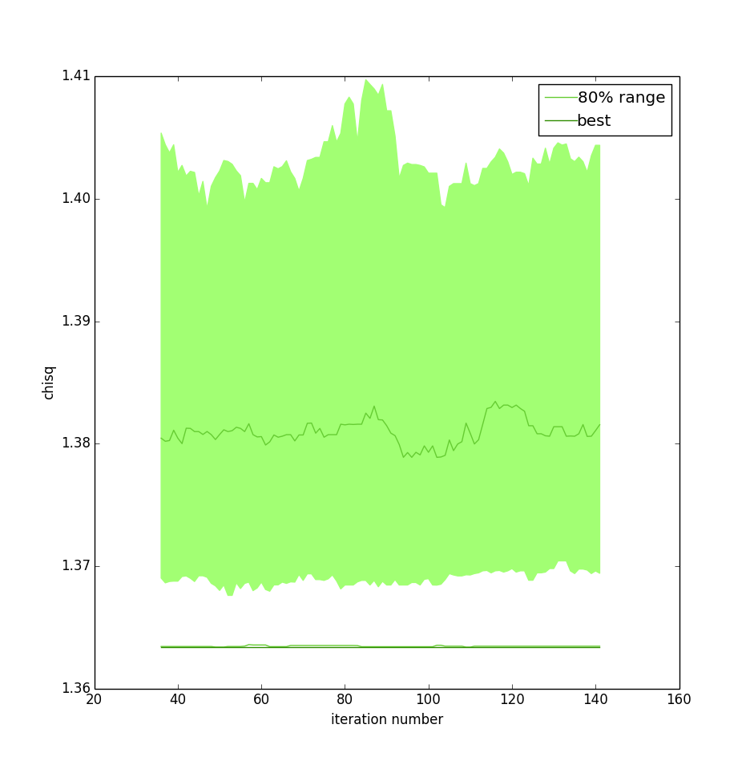
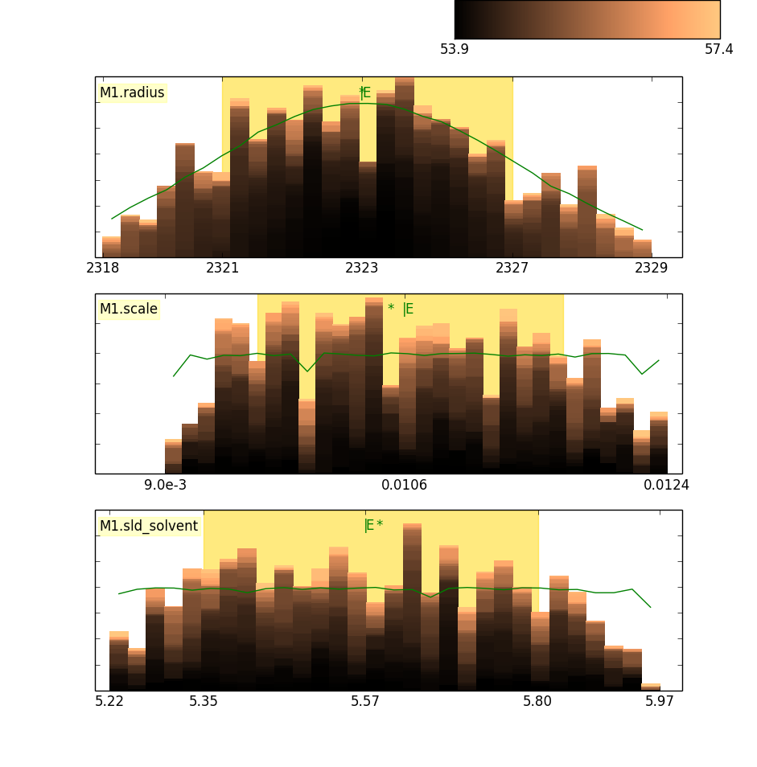
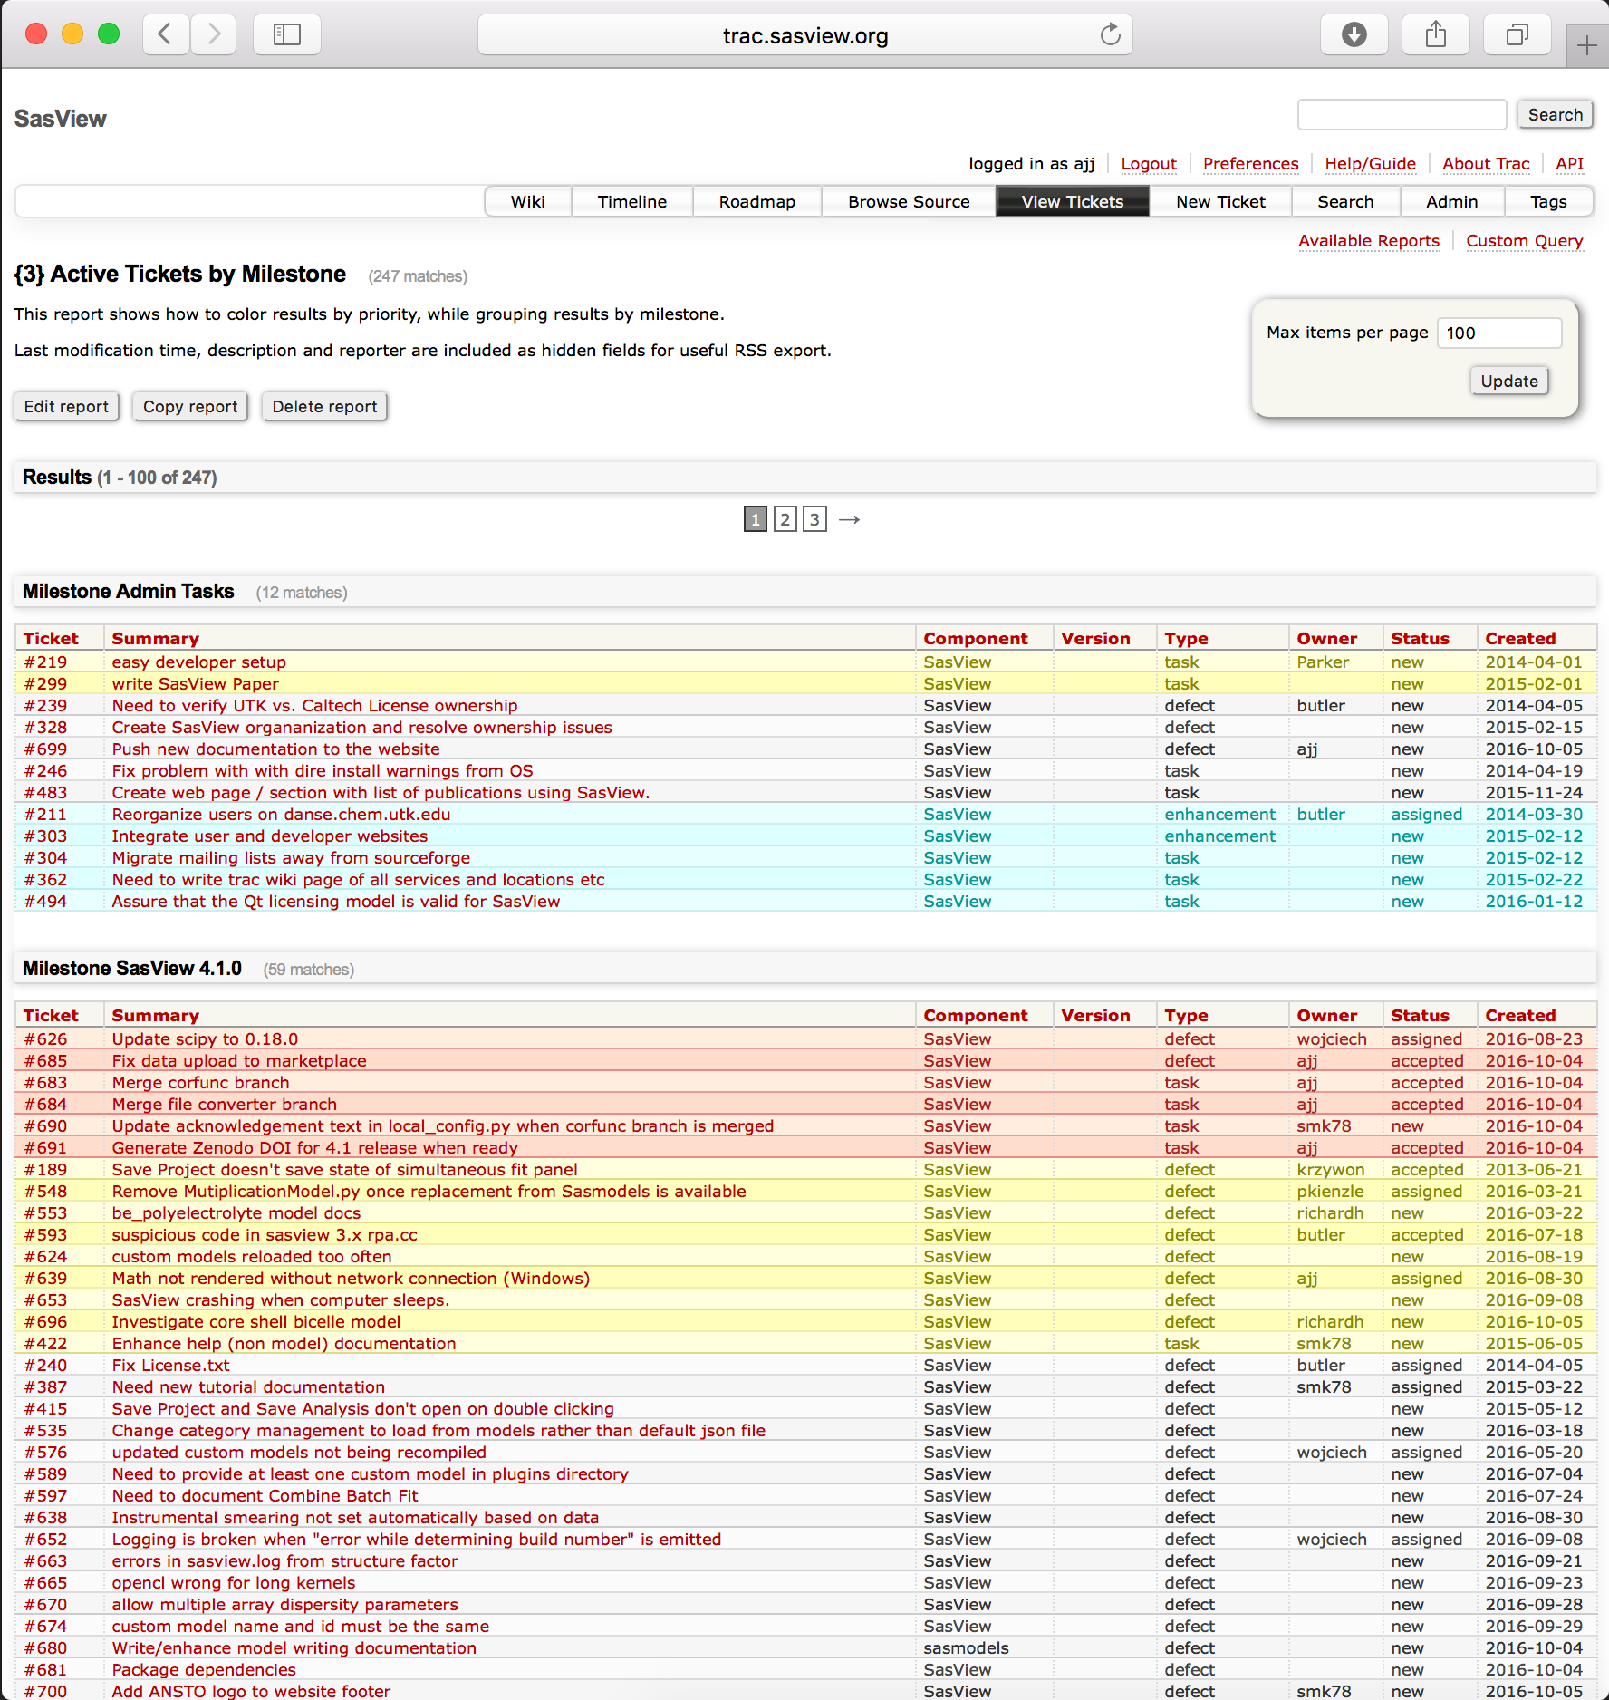
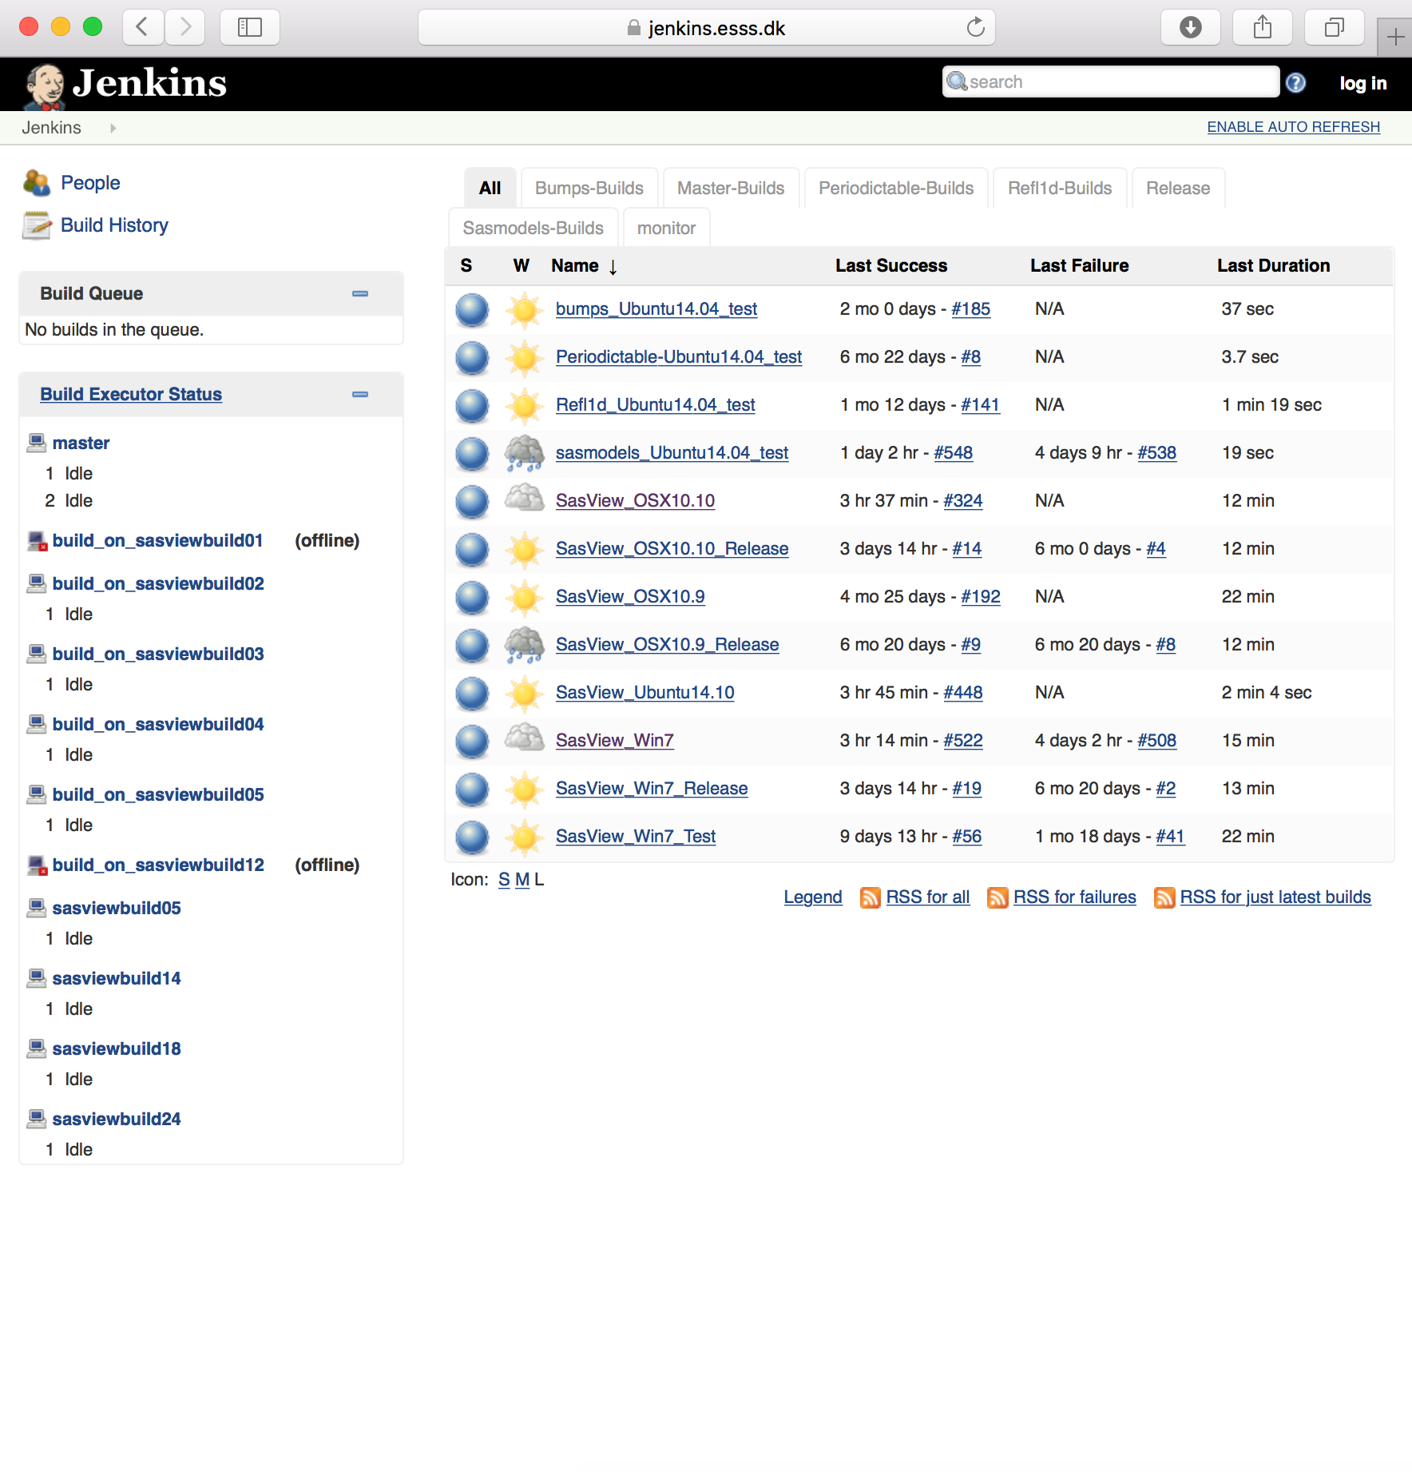


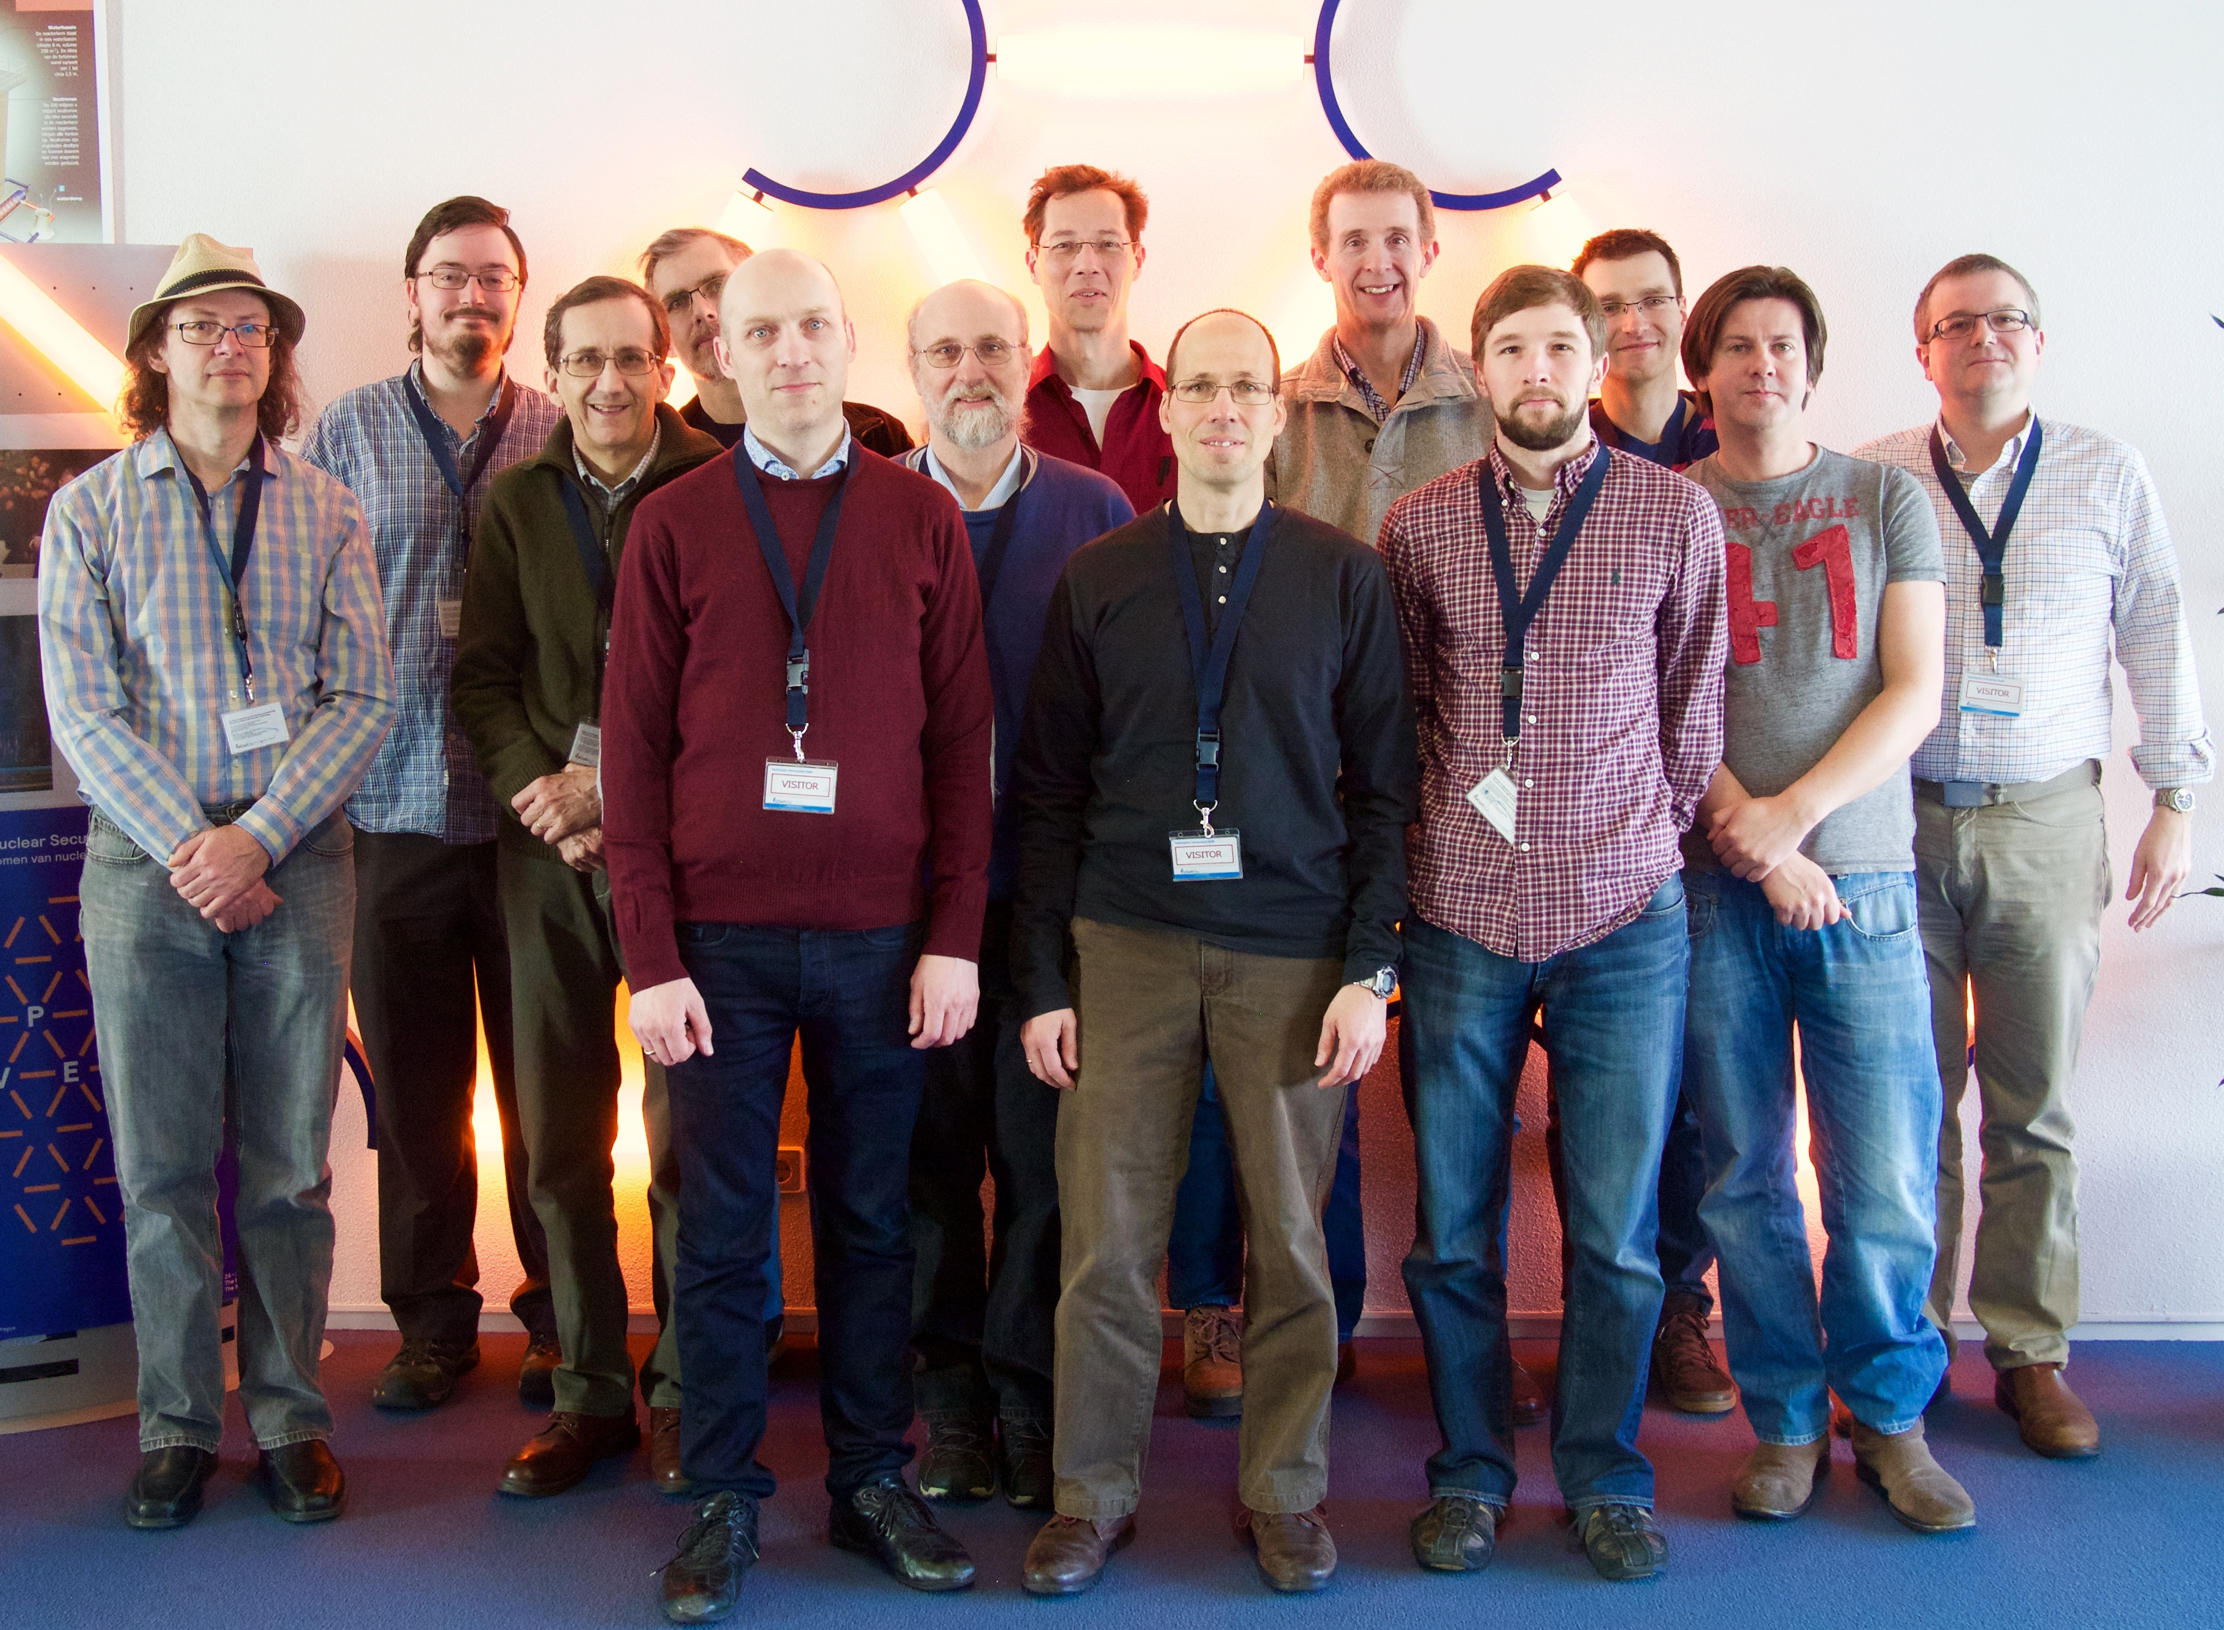



SasView 4.0
Data Analysis for Small Angle Scattering
www.sasview.org
Wide choice of built-in models (> 70)
Now in v4.0 - Easy to add your own using only python!
Data management
Common data formats supported, including NXCansas & cansas1D
Simultaneous fitting
Fit Quality (residuals)
Fitting
P(r) inversion
Invariant calculation
Generic parameter polydispersity
Choice of distribution and distribution parameters
Resolution smearing (pinhole and slit)
Automatically from data or provide parameters
New in SasView 4.0
Advanced Optimizer
Models
New models
New model package (sasmodels)
Separation of models from GUI
Simpler addition of models by users
Speed! GPU and parallel processing
www.nvidia.com
SESANS in sasmodels
Automatic transform of SANS model to P(z)
Example scripts for fitting SESANS data
Simultaneous fitting of SANS & SESANS
Documentation
Enhanced, updated documentation for models
Open, Collaborative, Community Development
Task and bug tracking trac.sasview.org
Code is open source and publicly hosted at Github
Bug and Enhancement Ticket System - Trac
Automated Builds
build.sasview.org
Bi-weekly developer calls
Regular Code Camps – next at ILL April 2017
Report Bugs!
See what we are working on!
5 Year Roadmap
Code testing!
Get the lastest dev builds!
Mailing lists – see www.sasview.org
Need Help? Email help@sasview.org
Paul Butler (NIST)
Mathieu Doucet (ORNL)
Andrew Jackson (ESS)
Steve King (ISIS)
Jurrian Bakker (TUD)
Wim Bouwman (TUD)
Miguel Gonzales (ILL)
Richard Heenan (ISIS)
Dirk Honecker (ILL)
Paul Kienzle (NIST)
Jeff Kryzwon (NIST)
Ricardo Leal (ORNL)
David Mannicke (ANSTO)
Torben Nielsen (ESS)
Lewis O’Driscoll (ISIS)
Steve Parnell (TUD)
Wojciech Potrzebowski (ESS)
Piotr Rozyczko (ESS)
Tim Snow (Diamond Light Source)
Adam Washington (Sheffield)
This project has received funding from the European Union’s Horizon 2020 research and innovation programme under grant agreement No 654000
and thanks to the many previous contributors, particularly Jae Hie Cho and Alina Gervaise
SasView was originally developed under NSF award DMR-0520547

